Slide 1


Slide 2
BRAKEN
Brandon
Kevoy
Nicholas
Rashmi

Slide 3
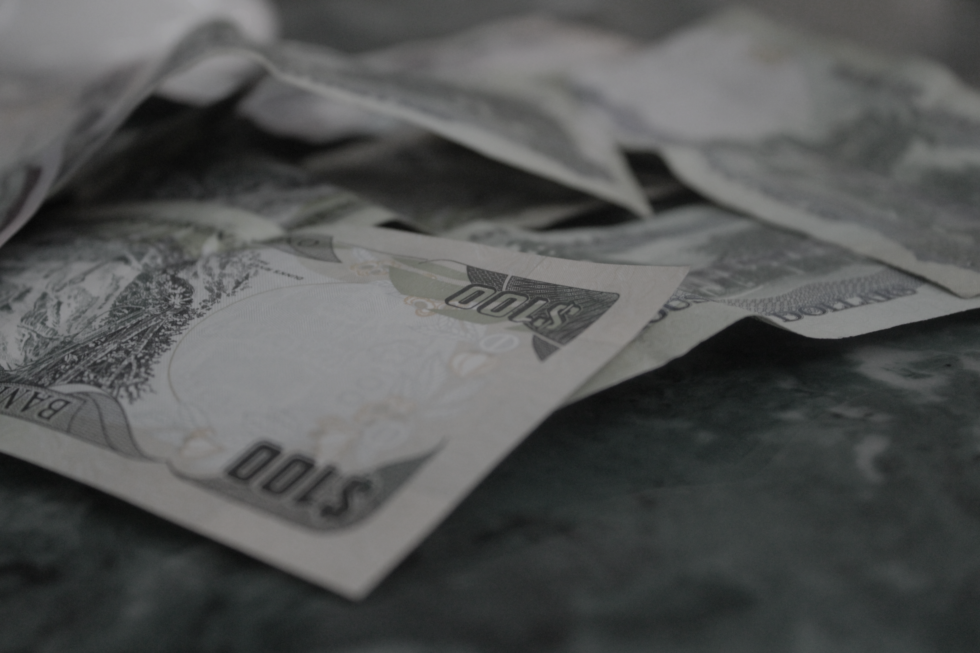
- Money -

Slide 4
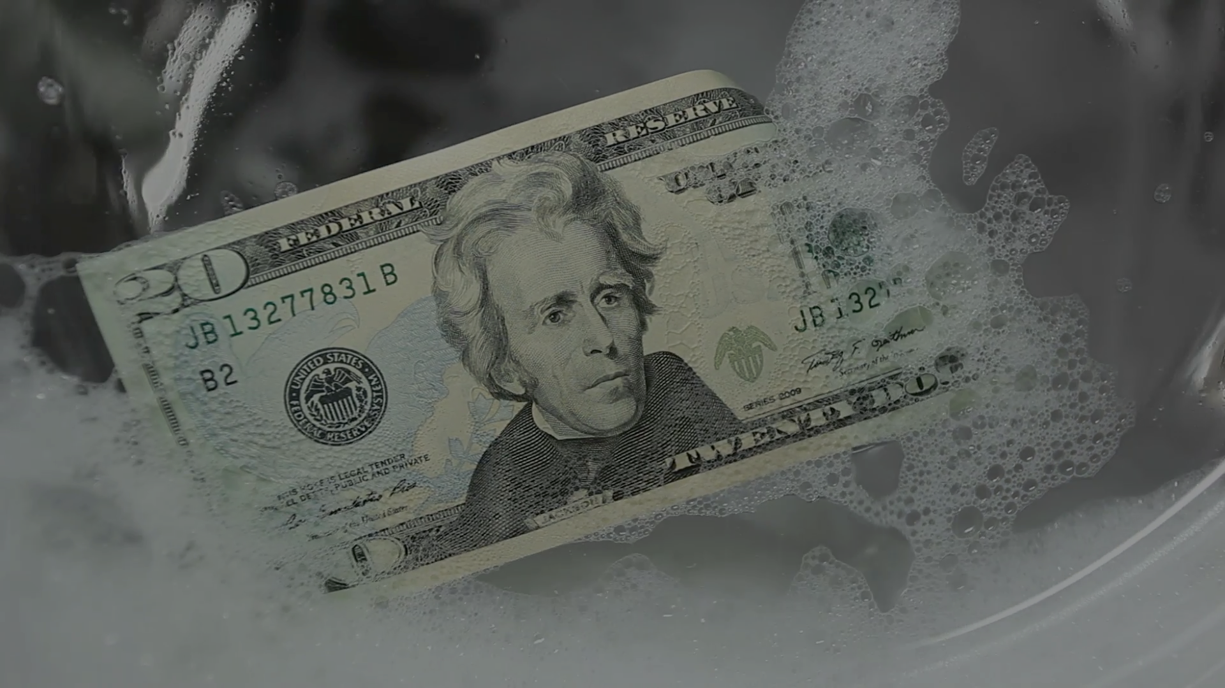

Slide 5


Slide 6
PALLETABLE

Slide 7

- Government -

Slide 8
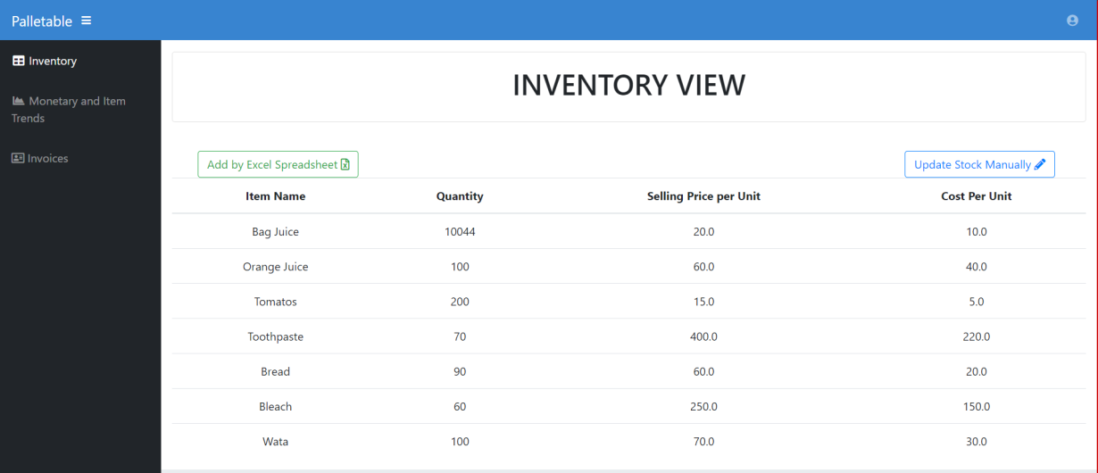

Slide 9
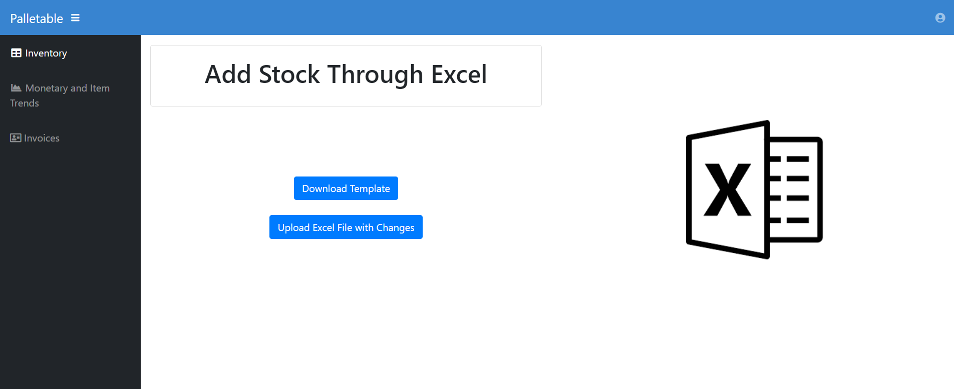

Slide 10
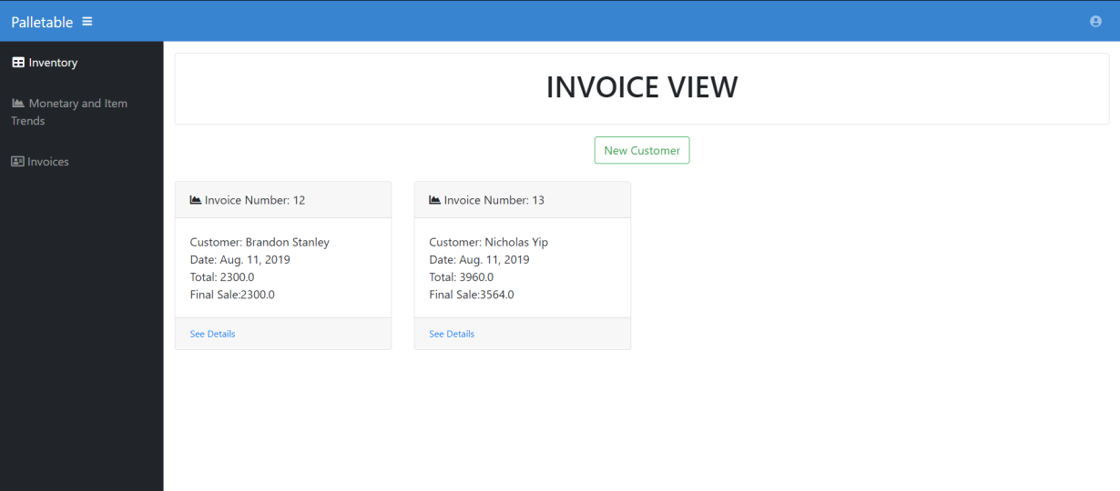

Slide 11
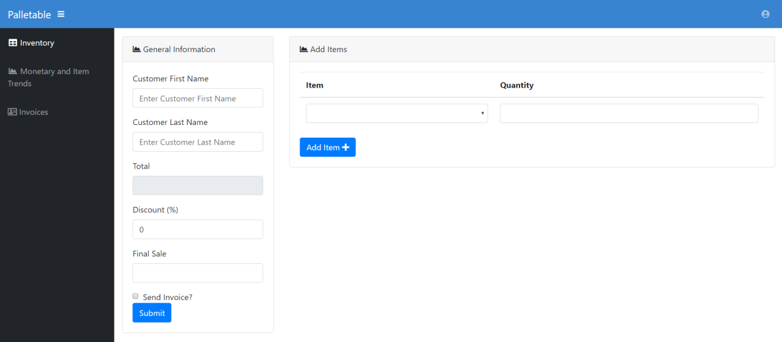

Slide 12
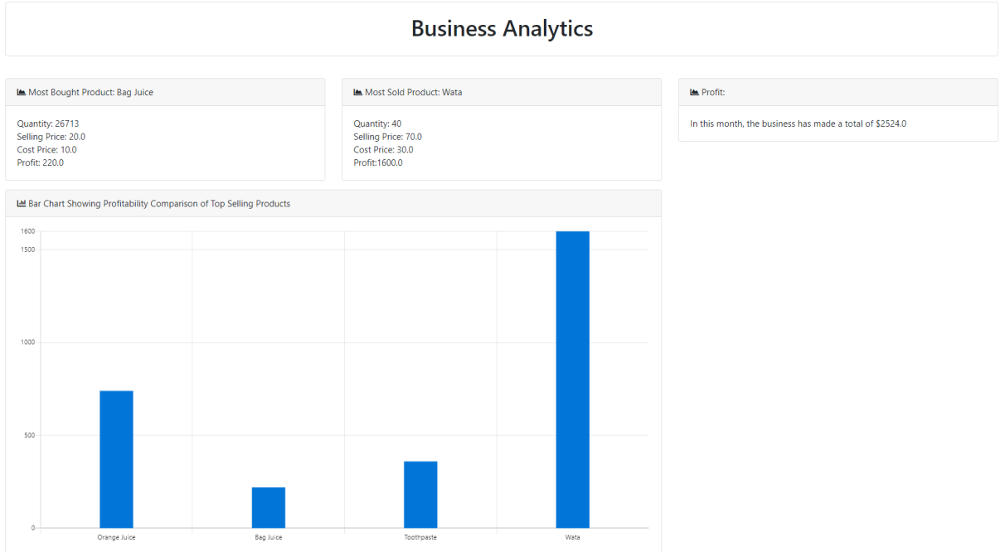

Slide 13

- Transparency -

Slide 14
Image References
Videoblocks.com
res.cloudinary.com
d3n8a8pro7vhmx.cloudfront.net
finance-monthly.com

Slide 15
Thank You
For your time

